Slide 1
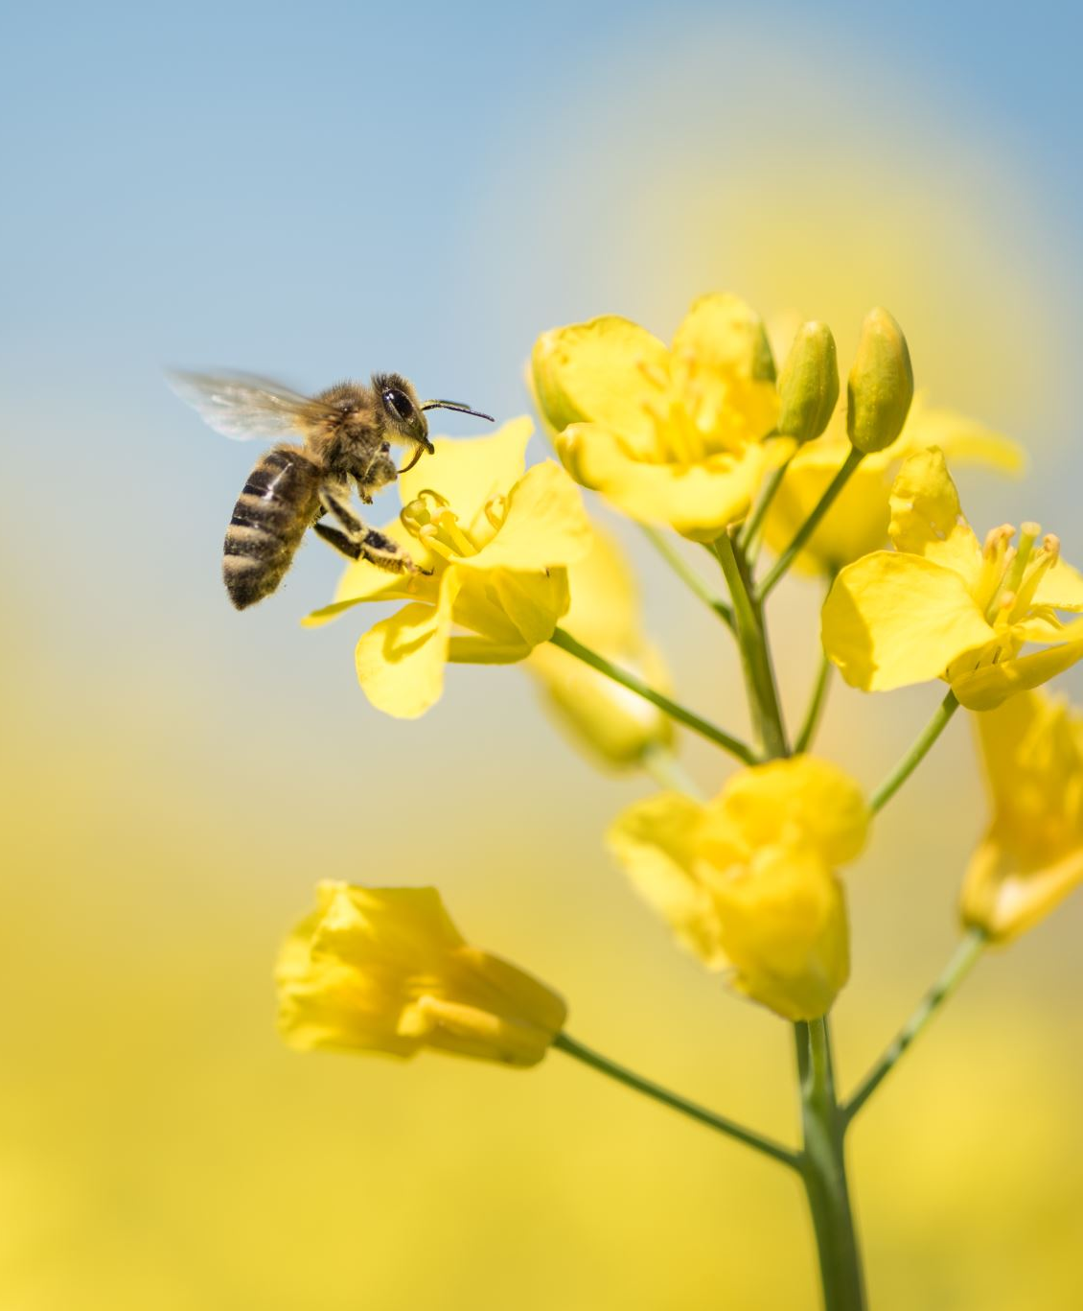
Biological Evolution
Mutations and Natural Selection

Slide 2
What is evolution?
Biological Evolution - change in allele frequency of a population from one generation to the next
Macroevolution – large scale change in the history of life such as when new groups of organisms(mammals) come about

Slide 3
How does evolution occur?
Mechanisms of biological evolution – migration, mutations, genetic drift, natural selection
(a mechanism is how something occurs)

Slide 4
What is a mutation? a change in DNA
What causes a mutation?
- Environmental factor such as UV light or other form of radiation can cause a change in the sequence of DNA bases leading to a change in the gene
- an error during DNA replication(incorrect base pairing) can cause a change in the sequence of DNA bases leading to a change in the gene

Slide 5
Some parts of DNA are more likely to be mutated than others
Mutations in DNA may lead to beneficial traits in a population which helps them survive environmental factors/changes - called Natural Selection

Slide 6
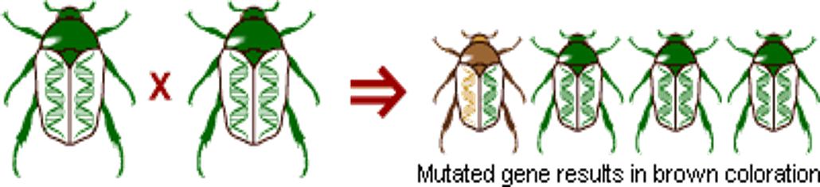
Mutation

Slide 7
How does Natural Selection work?
Natural Selection acts on variation(from mutations), a large number of offspring and competition among the offspring
Natural selection occurs when a trait that helps organisms survive longer and reproduce more becomes more common in the population
Examples of natural selection -
Beetles
Rock pocket mice
Bacteria
Giraffes

Slide 8
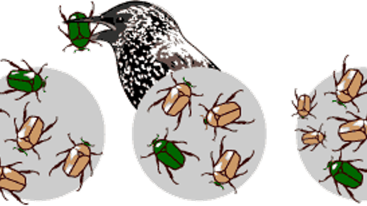

Slide 9
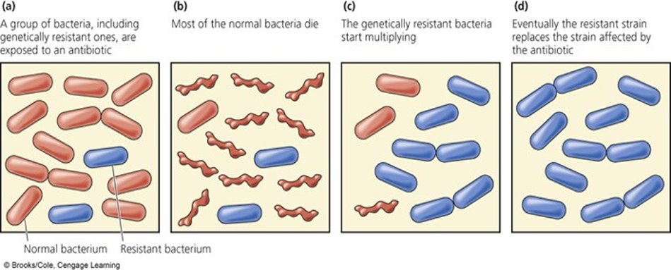

Slide 10
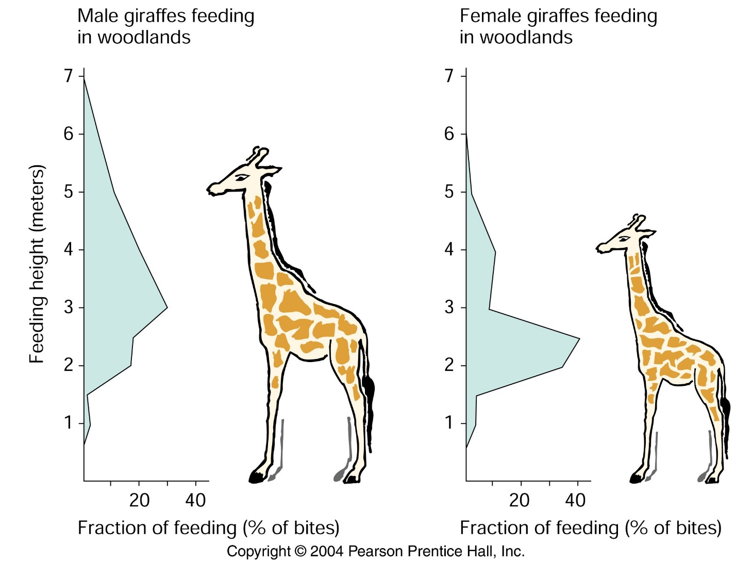
https://www.youtube.com/watch?v=60SZ7Hk0wdQ Need to show that trait is beneficial - Giraffe’s neck – feeding behavior or mate selection?

